Slide 1


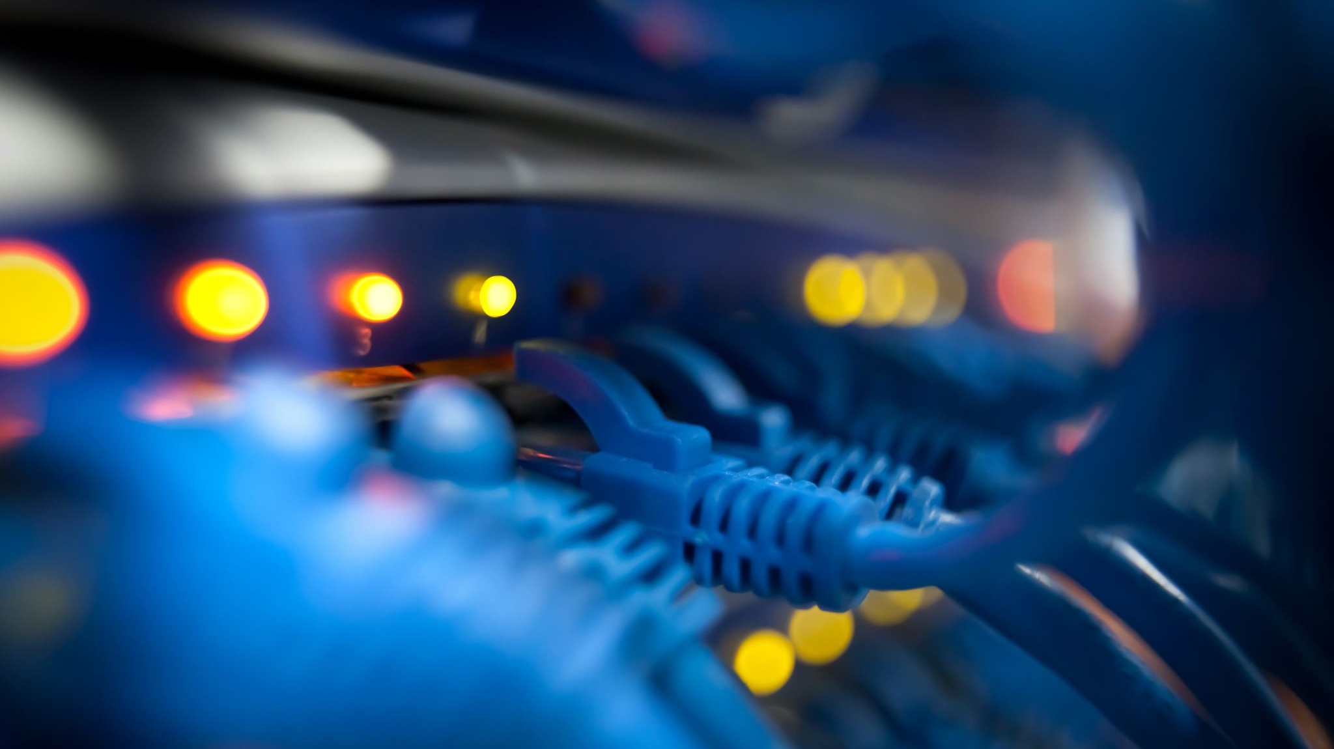
The Internet: A Global Network

Slide 2
Introduction
What is Internet
A global system of interconnected computer networks.
Allows devices worldwide to communicate and share information.
It’s the backbone of modern communication and technology.

Slide 3
Why is the Internet Important?
Global Communication:
Instant messaging, video calls, emails.
Information Access:
Vast resources of knowledge at our fingertips.
Entertainment:
Streaming, gaming, and social media.
Business:
E-commerce, online banking, virtual workplaces.
Education:
Online courses, digital libraries, collaboration tools.

Slide 4
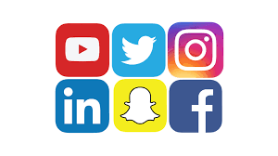
The Internet in Our Daily Lives
Social Media: Facebook, Instagram, TikTok – Connecting people worldwide.

Slide 5
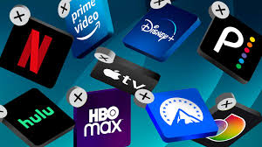
The Internet in Our Daily Lives
Streaming Services: Netflix, YouTube – Unlimited access to video content.
.

Slide 6
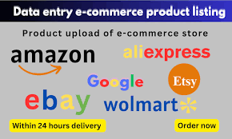
The Internet in Our Daily Lives
Online Shopping: Amazon, eBay – Global marketplace at your doorstep.

Slide 7

The Internet in Our Daily Lives
Education Platforms: Coursera, Khan Academy, and YouTube tutorials.

Slide 8
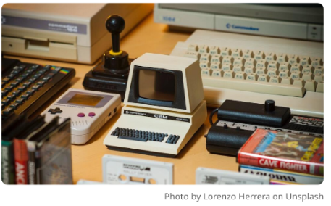
Origin of the Internet
1960s: The Internet started as a U.S. government project called ARPANET to connect research institutions.
.
Notes:
Advanced Research project Agency network

Slide 9
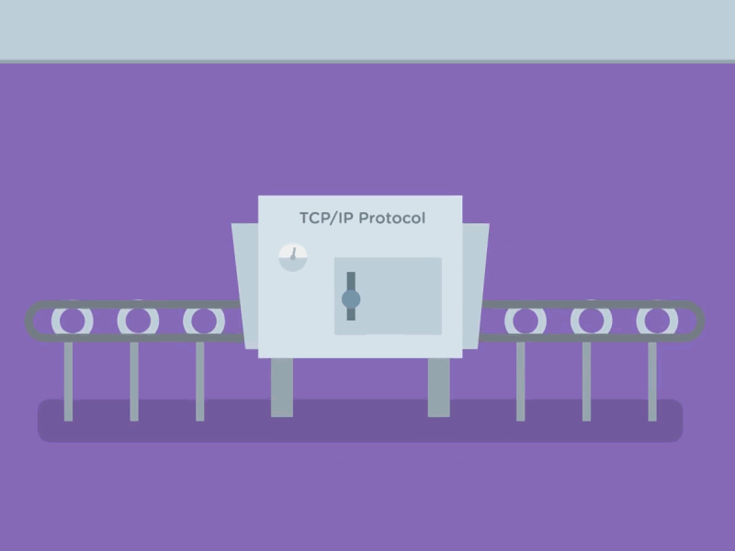
Origin of the Internet
1970s: The development of TCP/IP protocols by Vint Cerf and Bob Kahn, forming the foundation for modern networking.

Slide 10
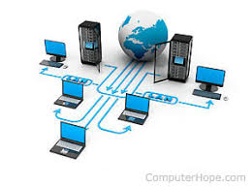
Origin of the Internet
1980s: NSFNET expanded ARPANET, connecting universities and research institutions.
.
Notes:
National Science foundation Network

Slide 11
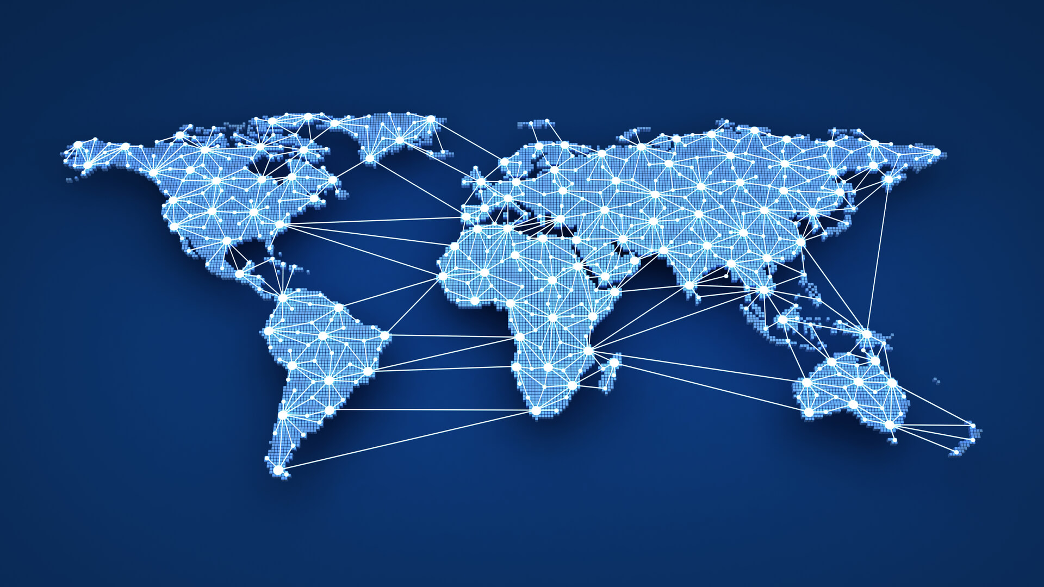
Origin of the Internet
1990: Tim Berners-Lee invented the World Wide Web (WWW), introducing the first web browser and HTML.
.

Slide 12
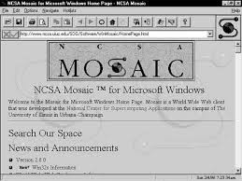
Origin of the Internet
1993: The web became public with the first popular browser, Mosaic.
1990s – Present: The rapid growth of the Internet, rise of social media, e-commerce, and mobile devices.

Slide 13
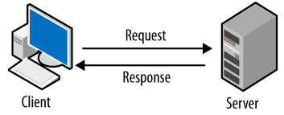
How the Internet Works – An Overview
Internet Protocol (IP):
A set of rules for data exchange.
Servers and Clients:
The Internet connects devices (clients) to powerful computers (servers) that host websites and services.

Slide 14
Internet Architecture
ISPs (Internet Service Providers):
Companies that provide internet access (e.g., PTCL, Fibernet).
Data Centers and Routers:
The backbone of the Internet, housing servers and routing data to its destination.

Slide 15
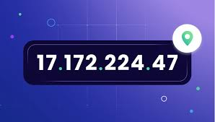
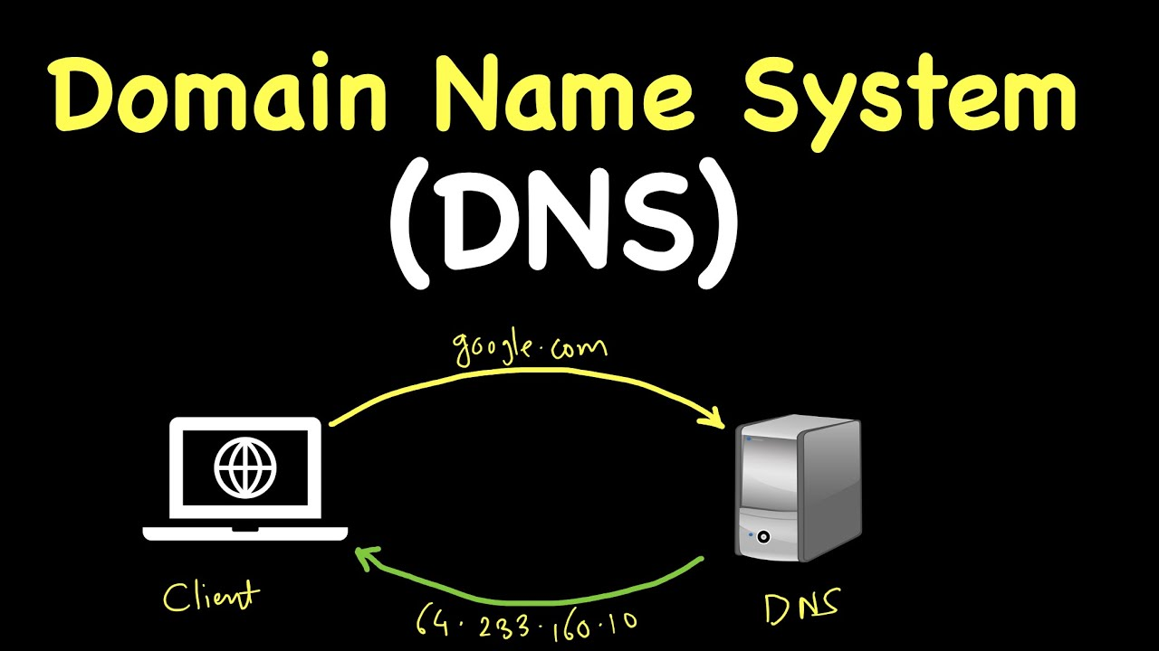
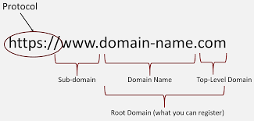
Key Terms
IP Address: A unique address that identifies each device on the Internet.
Domain Names: Human-readable addresses (e.g., google.com).
DNS (Domain Name System): Converts domain names to IP addresses so computers can communicate

Slide 16

The first message sent over the Internet was “LO”. The system crashed before they could finish typing “LOGIN.”

Slide 17
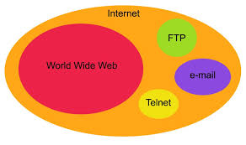
The World Wide Web (WWW)
The Internet vs. WWW: The Internet is the infrastructure, while the WWW is a service that runs on it.

Slide 18
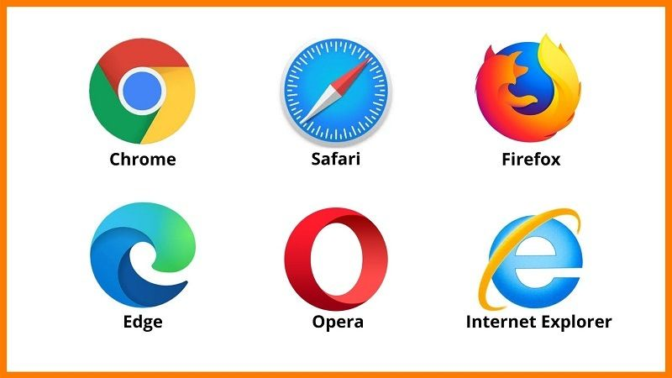
The World Wide Web (WWW)
Web Browsers: Programs like Chrome, Firefox, and Edge that allow users to access the web.

Slide 19
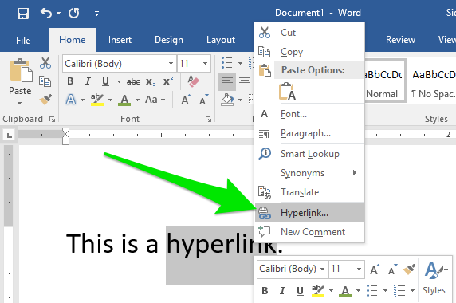
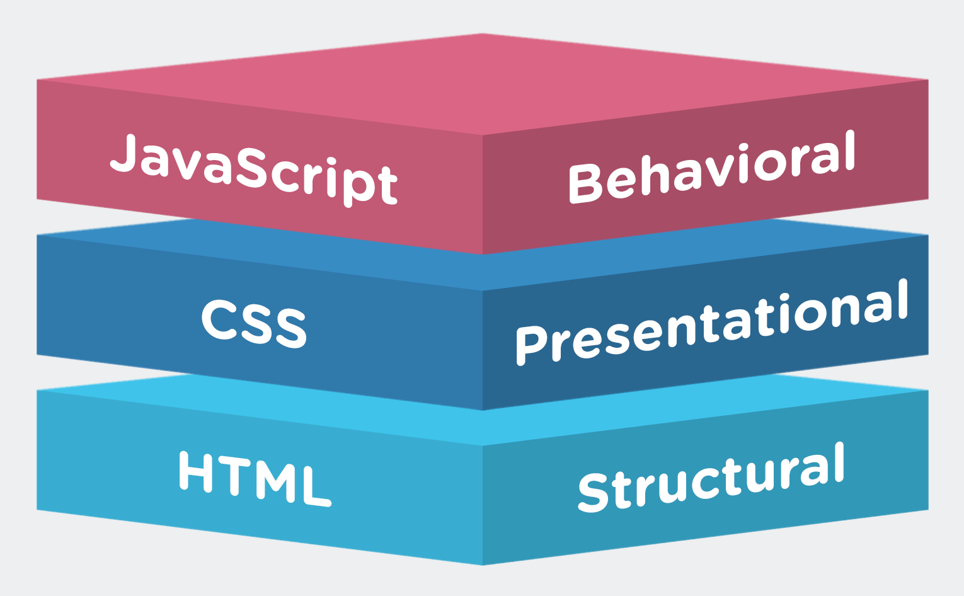
Hyperlinks and Web Pages
Hyperlinks: Clickable links that connect different web pages.
Basic Web Page Structure:
HTML: The skeleton of a web page.
CSS: Adds style and design.
JavaScript: Adds interactivity.

Slide 20
Internet Protocols
HTTP (HyperText Transfer Protocol):
How web pages are transferred.
HTTPS:
Secure version of HTTP.
FTP (File Transfer Protocol):
Used to transfer files.
TCP/IP (Transmission Control Protocol/Internet Protocol):
Ensures data is sent and received reliably.

Slide 21
How Data Travels Over the Internet
Data Packets: Information is broken into small packets before being sent.
Routers and Switches: Guide packets from one device to another across the network.
Path Selection: The quickest route across the Internet.

Slide 22
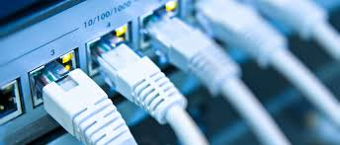
Internet Access Technologies
Broadband: High-speed internet using various methods.

Slide 23
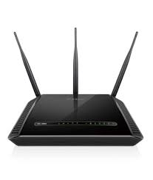
Internet Access Technologies
DSL (Digital Subscriber Line): Internet over telephone lines.

Slide 24
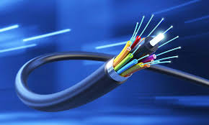
Internet Access Technologies
Fiber Optic: Uses light to transmit data at ultra-fast speeds.

Slide 25
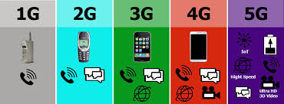
Internet Access Technologies
Mobile Data: 3G, 4G, and 5G for wireless internet access.

Slide 26
Fun Fact
Early internet speeds in the 1990s were around 56 kbps. Today, we can enjoy speeds over 1 Gbps

Slide 27
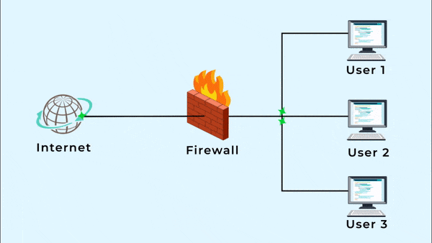
Cybersecurity Basics
Firewalls: Protection between a trusted internal network and untrusted external networks.

Slide 28
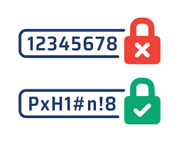
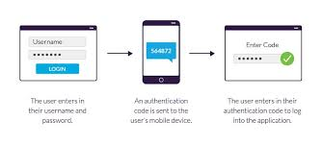
Cybersecurity Basics
Strong Passwords: The foundation of internet safety.
Two-Factor Authentication (2FA): Adds an extra layer of security.

Slide 29
Internet Search Engines
How Search Engines Work: They crawl, index, and rank web pages.
SEO (Search Engine Optimization): The practice of improving a website’s visibility in search engines.

Slide 30
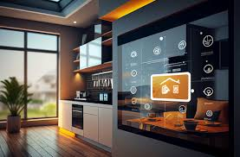
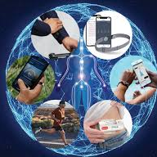
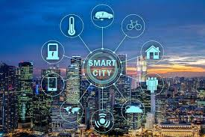
Internet of Things (IoT)
Smart Homes: Devices like smart thermostats and lights.
Wearables: Smartwatches, fitness trackers.
Connected Cities: Traffic control, smart grid technology.

Slide 31
Social Media and Its Impact
Pros: Connects people, spreads ideas, business opportunities.
Cons: Privacy concerns, cyberbullying, misinformation.

Slide 32
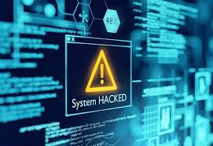
The Dark Side of the Internet
Cybercrime: Hacking, identity theft, and ransomware.

Slide 33
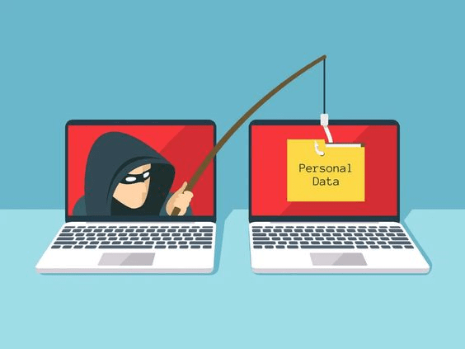
The Dark Side of the Internet
Phishing Scams: Fake emails and websites that steal personal information.

Slide 34
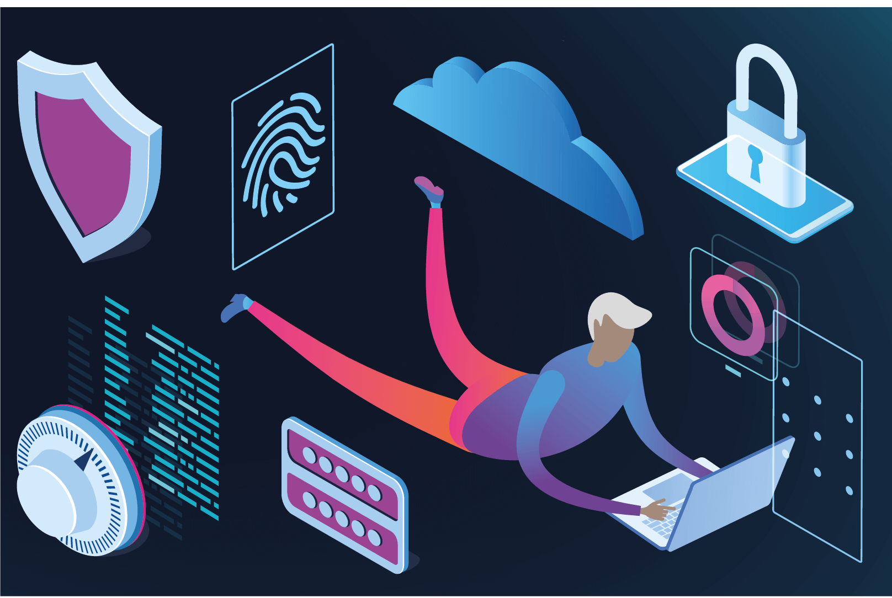
The Dark Side of the Internet
Online Safety: Tips for staying safe online, like not clicking suspicious links.

Slide 35
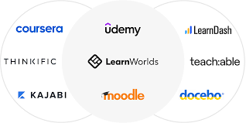
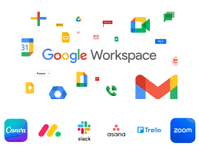
Internet in Education
E-learning Platforms: Coursera, Udemy, Khan Academy.
Digital Collaboration: Google Docs, Microsoft Teams.
Online Research Tools: Google Scholar, digital libraries.

Slide 36
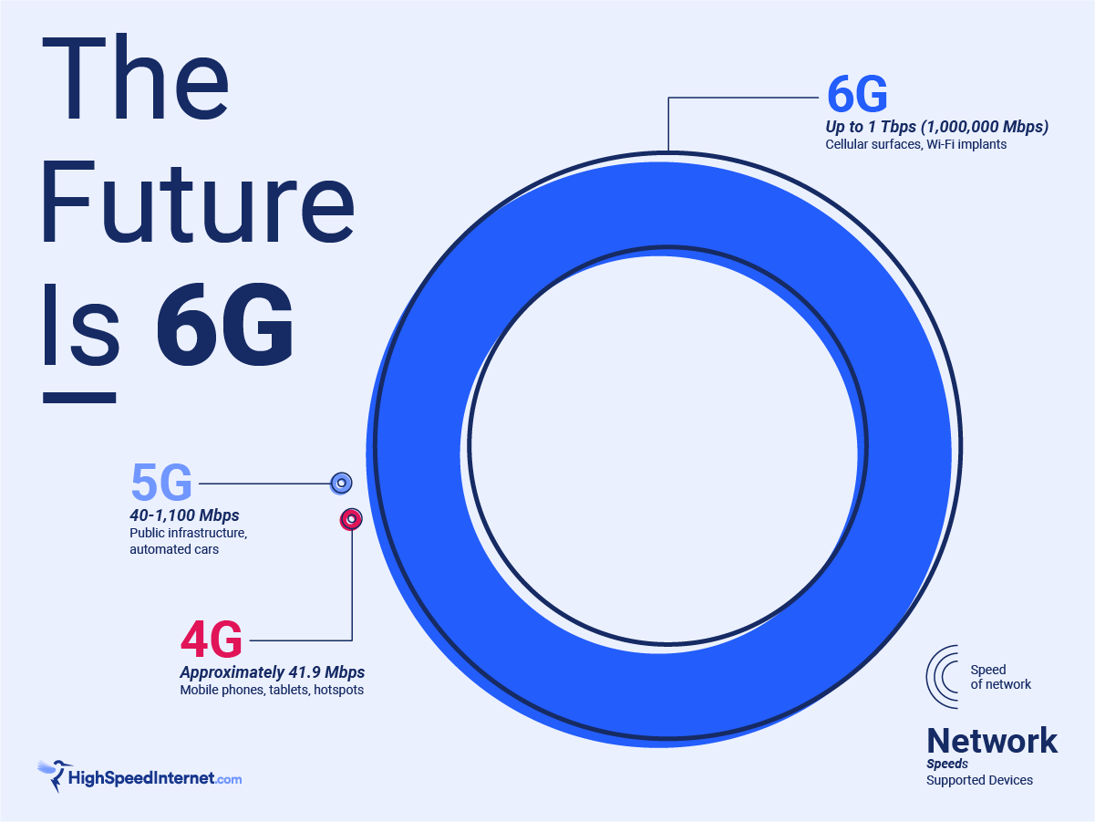
The Future of the Internet
6G Technology: Next-generation internet speeds.

Slide 37
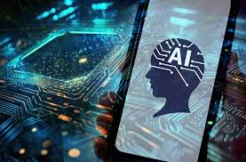
The Future of the Internet
AI and the Internet: How artificial intelligence is transforming industries.

Slide 38

The Future of the Internet
Quantum Computing

Slide 39
Fun Fact
Currently, over 30 billion devices are connected to the Internet worldwide.

